Slide 1
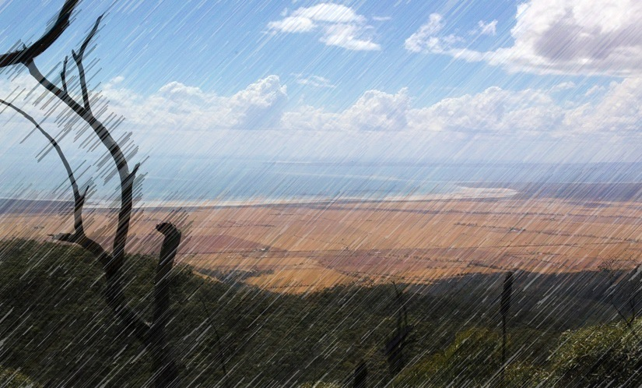
National Landcare Conference
16th September 2015
PRESENTERS
Danny Doyle
Northern & Yorke NRM Upper North District Manager
Anne Brown
Greening Australia
Andrea Tschirner
Acacia Park Consulting

Slide 2
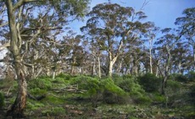
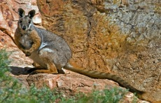
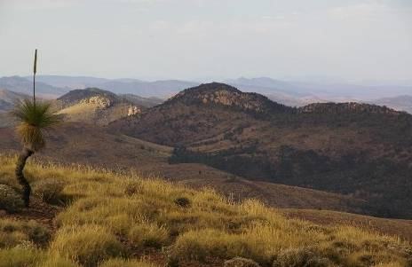
Where is the Southern Flinders?
The Southern Flinders Ranges project area covers approximately 1.27 million hectares, ranging from Port Pirie in the south, Hawker in the north, the Flinders-Olary Plains to the east and Spencer Gulf to the west.

Slide 3
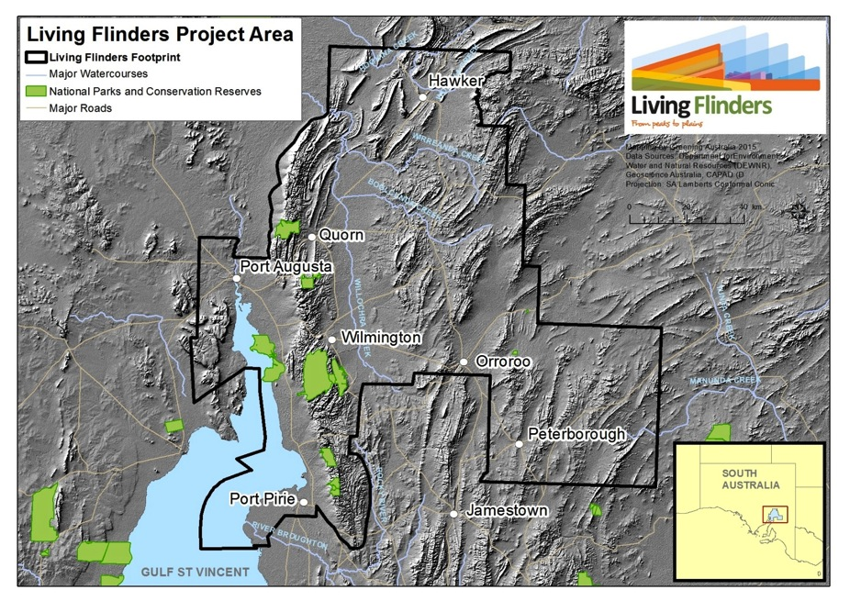

Slide 4
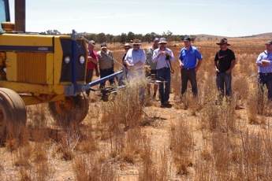
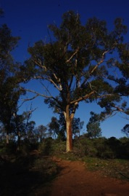
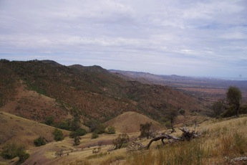
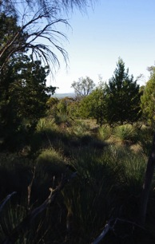
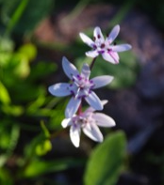
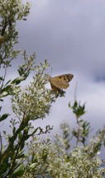
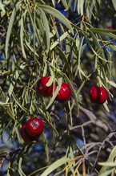
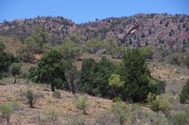
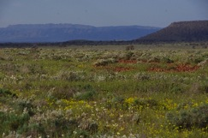
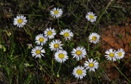
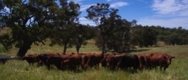
How did Living Flinders Evolve?

Slide 5
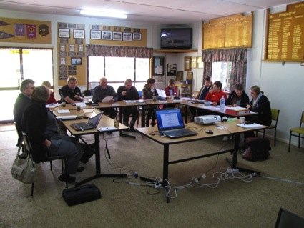
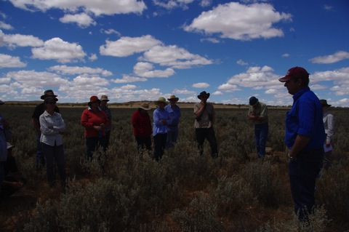
Living Flinders Conservation Action Planning Process (CAP)

Slide 6
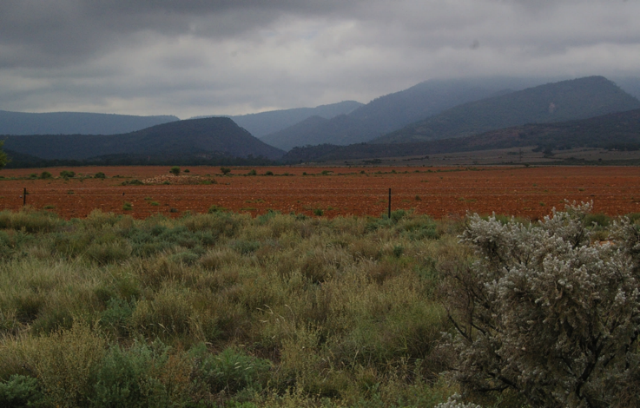
Objectives of the Living Flinders Program…

Slide 7
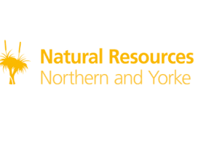
Partnerships
‘Alone we can do so little; together we can do so much’
Individual Landholders
Acacia Park Consulting
(Fox Baiting Contractors)

Slide 8
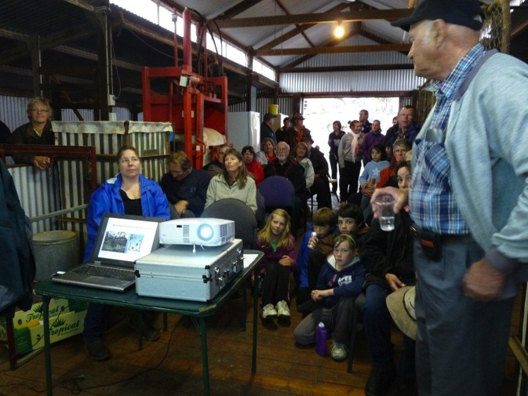
Living Flinders Community Engagement
Notes:
Community engagement and education is an ongoing part of the project .
Very popular workshop
This is what happens when 24 RSVP and 60 turn up then it rained.

Slide 9
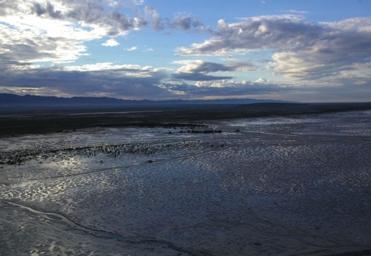
Why the
Southern Flinders?
Fact:
The Living Flinders region contains some of Australia’s most ancient natural landscapes supporting an incredible diversity of plants and animals
Notes:
ANNE BROWN TO START HERE

Slide 10
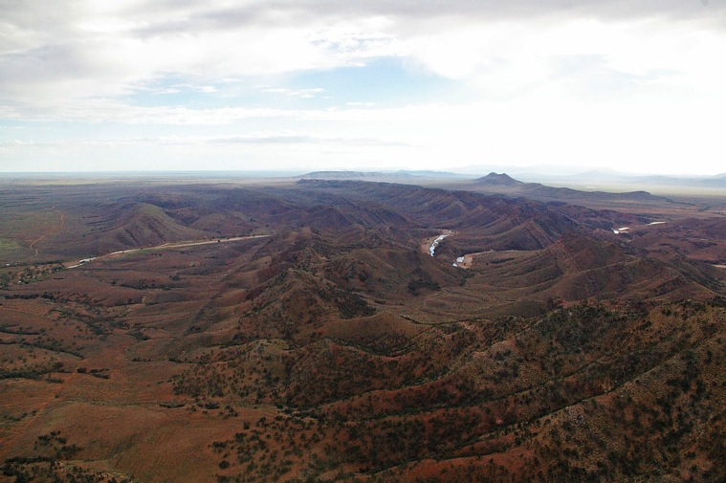
Ancient Landforms…

Slide 11
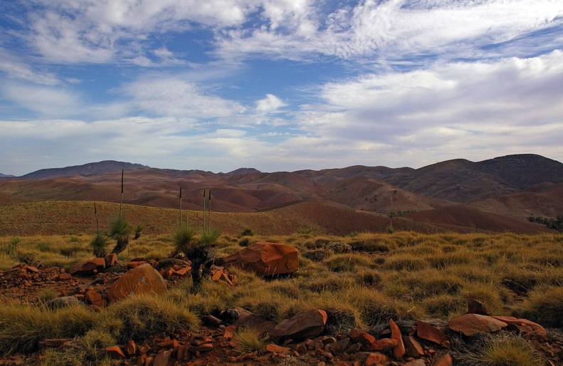
Iconic Landscapes…

Slide 12
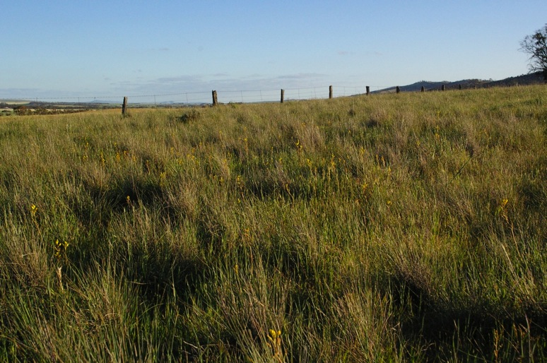
Grasslands…

Slide 13
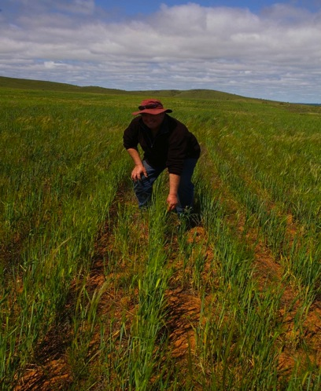
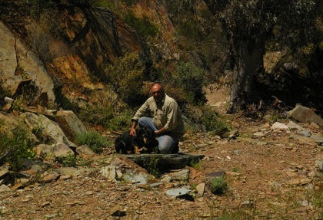
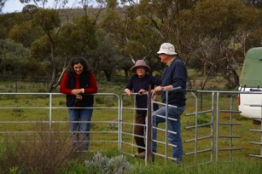
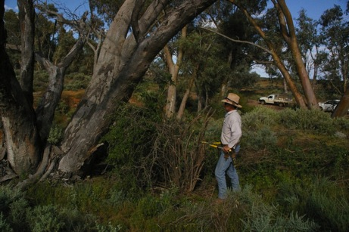
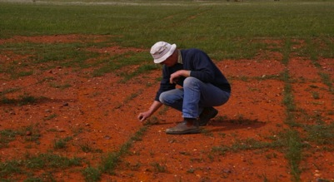
Enthusiastic Landowners…

Slide 14
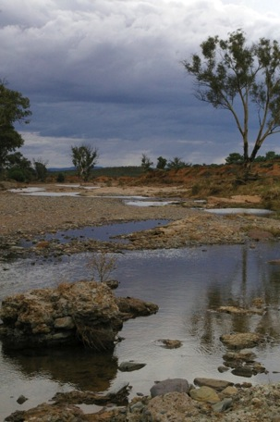
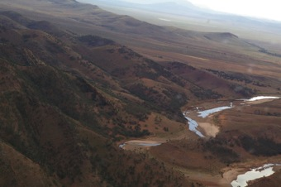
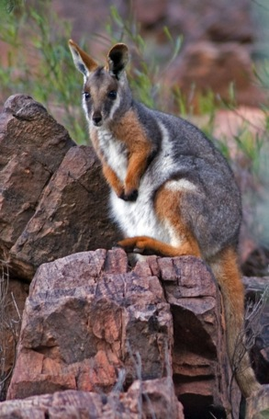
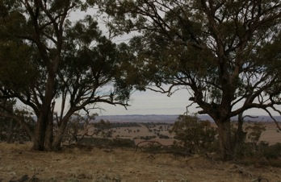
Natural Assets…

Slide 15
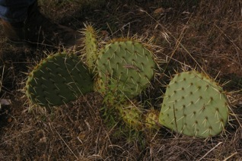
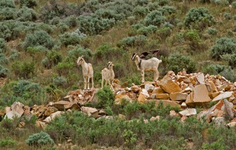
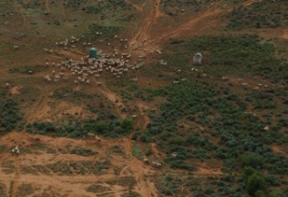
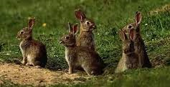
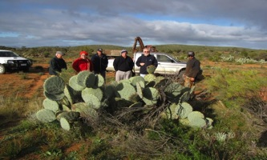
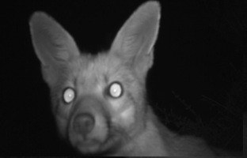
Threats…

Slide 16
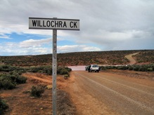
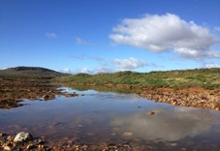
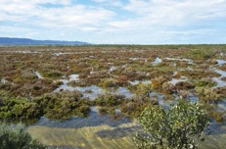
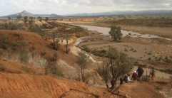
Projects…
Four Rivers Project

Slide 17
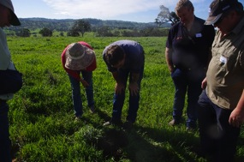
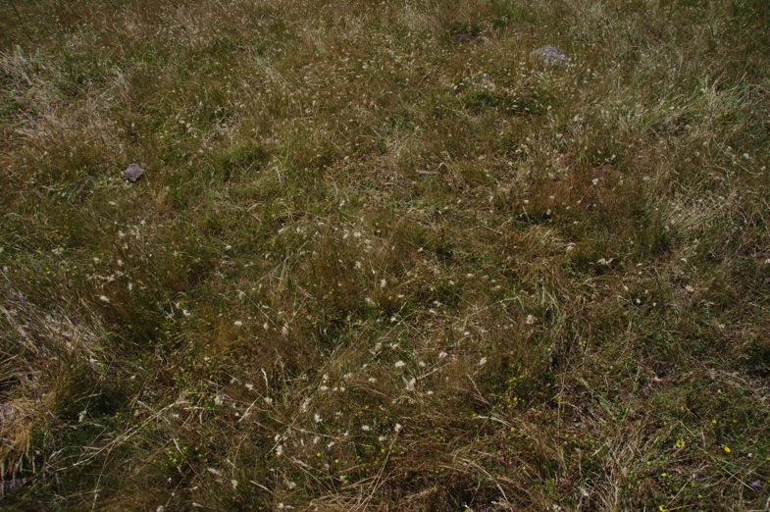
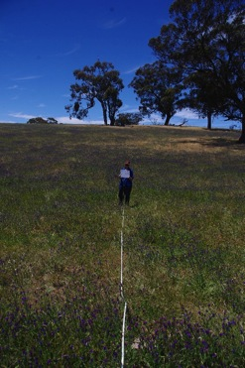
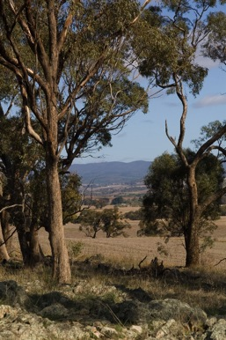
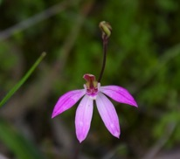
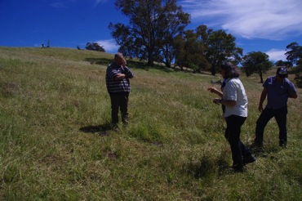
Grey Box Project

Slide 18
Other Landscapes…
Southern Ranges Collaboration
Goat Control
WONS
Mt Remarkable to the Sea
Riparian restoration
Coastal restoration
Pest Management

Slide 19
Arden Vale
Facts:
In 2015…
70000ha Integrated Pest Management Project
7000 Goats removed by muster & aerial shoots.
Riparian weeds removed from 1000 ha
Cactus controlled over 8700 ha
Notes:
Rugged landscape north of Quorn.
Yellow footed Rock Wallabies in deep gorges.
the Project is-
- Connecting landowners
- improving habitat
by removing Goats, riparian weeds, cactus foxes and cats

Slide 20
Arden Vale Fox Baiting Project

Slide 22
Project background
Marginal cropping country
Mixed sheep breeds, cattle in valley country
Goats
Tourism
Conservation
Diverse community with a small population: long time farmers,
tourism businesses, conservation properties, hobby farmers and lifestyle blockies

Slide 23
What’s involved?
Regional baiting program covering 60,000ha
Focus area located in the Arden Vale region, north of Quorn
29 landholders are involved with the program – 100% participation rate

Slide 24
Permanent bait stations (installed with landowners)
1080 poison baits are buried at bait station dropper during late summer, Autumn and Spring (3 rounds a year)
Each site is visited 3 times during each round, (usually within a 4 week window depending on weather conditions).
All un-eaten baits are retrieved at the end of the baiting round.

Slide 25
Baits used
Fox Off (manufactured bait)
Dried Kangaroo meat bait injected with 1080
Tuna Oil attractant brew trialled in Spring 2014

Slide 26
Results so far…
Total number of baits laid 4,500
Bait uptake average 16%
[192 foxes shot 2014 – landholder count only]

Slide 27
MONITORING
Collecting good data helps us to:
establish good relationships with landholders
achieve positive results on the ground.
make baiting methods safer and more efficient
reinforce (or dismiss) anecdotal evidence.
“….we don’t have foxes on
our property.”

Slide 28
Remote Sensor Cameras
Reconyx Hyperfire cameras
15 cameras placed 1km apart in Treatment area (baitied)
15 cameras in control area (outside of regional baiting program area).

Slide 29
Camera trap data
The Relative Abundance Index is calculated to
account for trapping effort (Relative Abundance = total fox sightings/total trap nights*100)

Slide 30
Scat Analysis
There has been a steady increase in the number of scats at the base of droppers over the duration of the project.
Sminthopsis dolichura SOURCE: John Read

Slide 31
GIS Data – ArcView and QGIS
Analyse bait uptake data
Distance to water
Trends in uptake
Refine bait station positions and make recommendations for future regional baiting

Slide 32
SPIN OFFS – it’s not all about killing foxes
Notes:
The region has had limited exposure to regular communications with NRM activities or for a very long time
Many farmers disgruntled with the handling of Soil Board change-over
New landowners in the district & new project focus has re-engaged many farming families

Slide 33
Key Achievements
Project has kicked a lot of goals in a short period of time
Good NRM is about COMMUNITY, and this is greatly helped by having a capacity to put PEOPLE on the ground.

